Slide 1
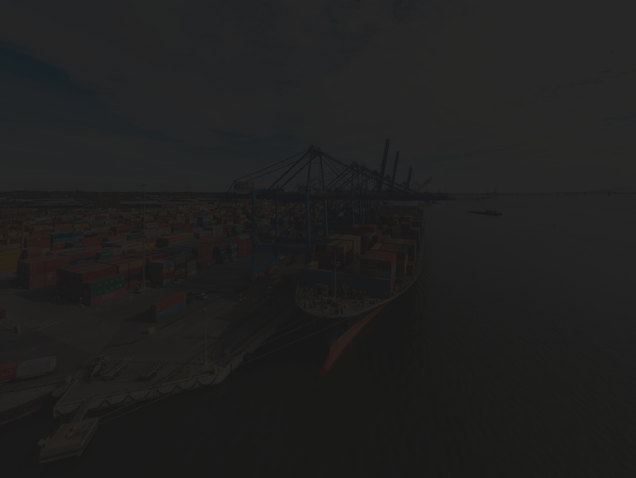



Slide 2
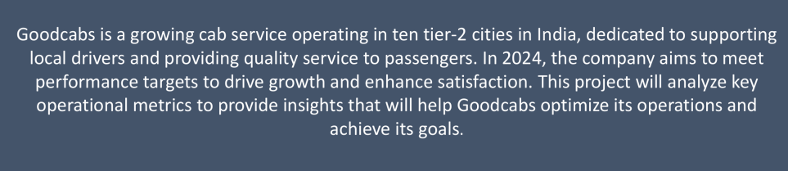

GOOD CABS
WELCOME TO OUR COMPANY

Slide 3

TABLE OF CONTENTS
UNDERSTANDING PROBLEM
DATA MODEL
DASHBOARDS
PRIMARY QUESTIONS
AD-HOC REQUESTS
FURTHER ANALYSIS AND RECOMMENDATIONS
FIANL NOTE: END-OF-YEAR-TARGETS

Slide 4
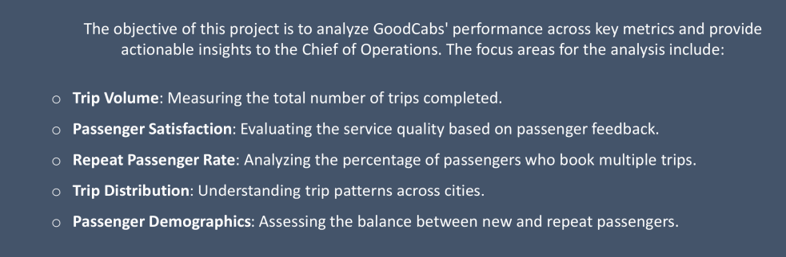
UNDERSTANDING PROBLEM

Slide 5
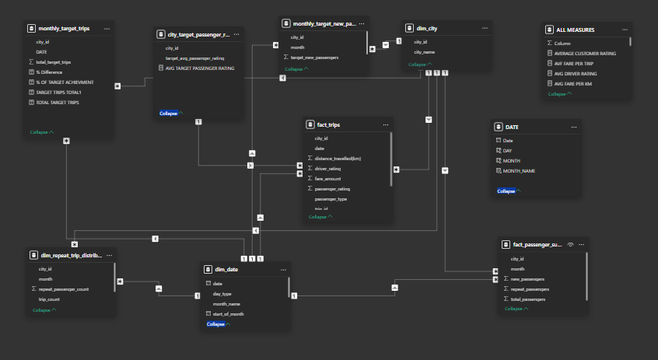
DATA MODEL

Slide 6
DASHBOARDS

Slide 7



EXPLORE MORE INSIGHTS

Slide 8
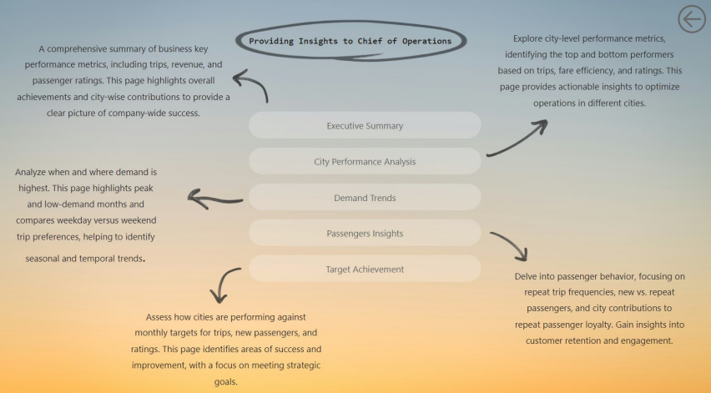

Slide 9
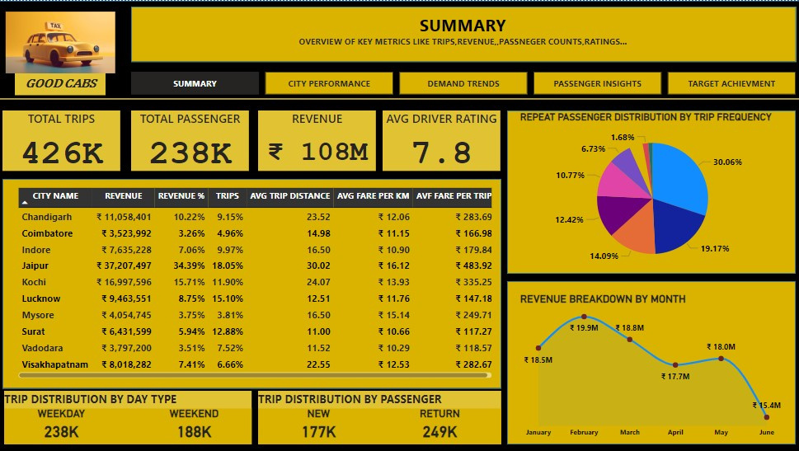

Slide 10
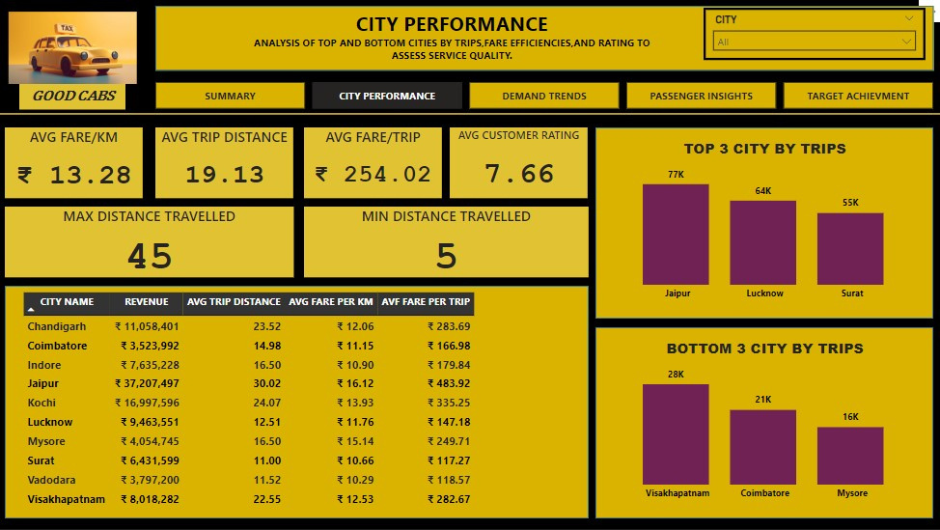

Slide 11
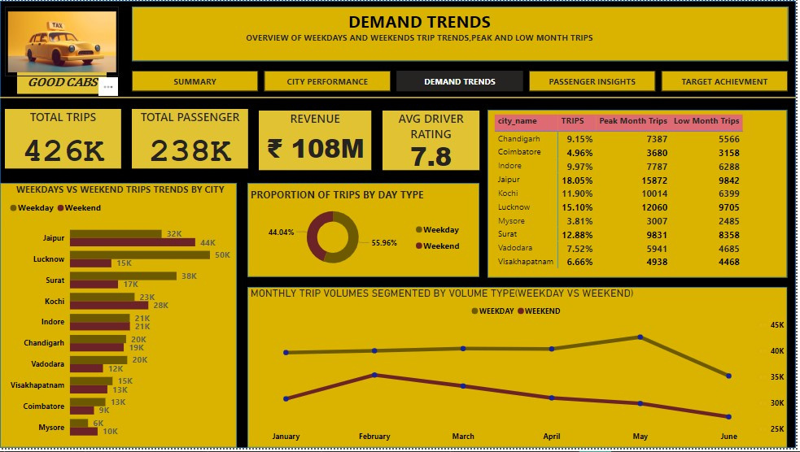

Slide 12
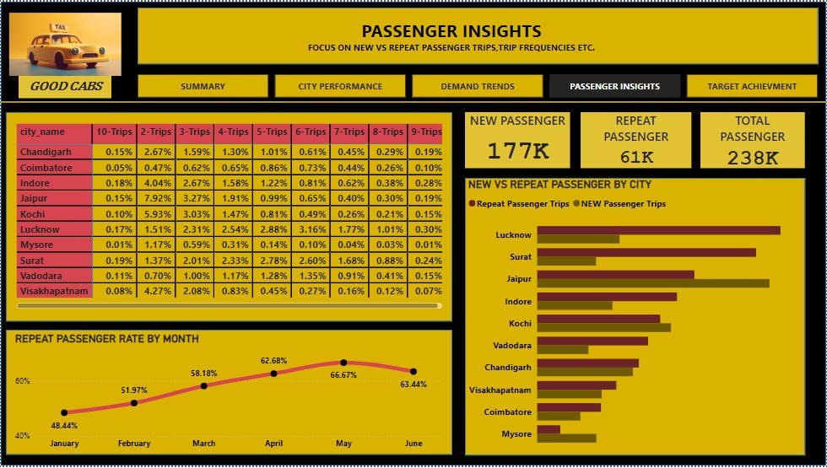

Slide 13
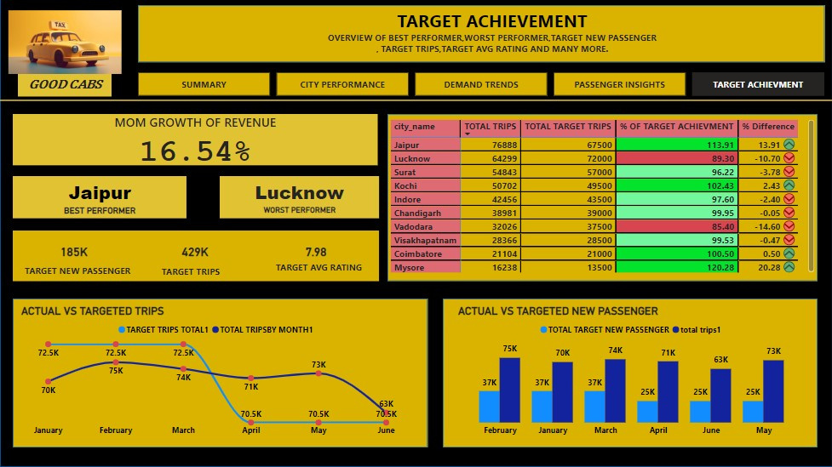

Slide 14
PRIMARY ANALYSIS

Slide 15
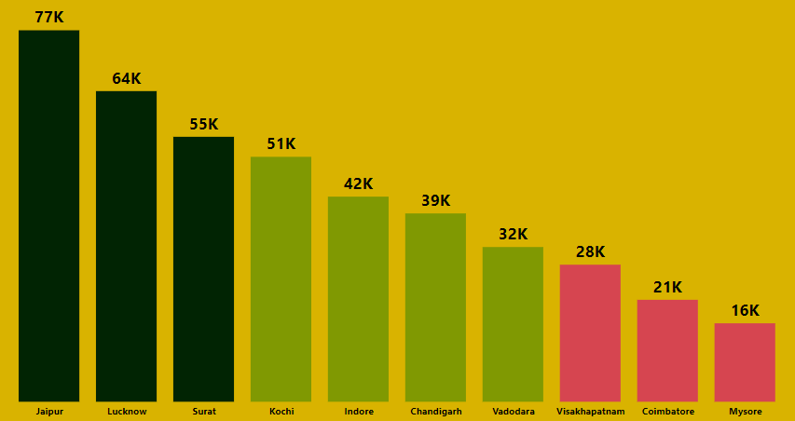
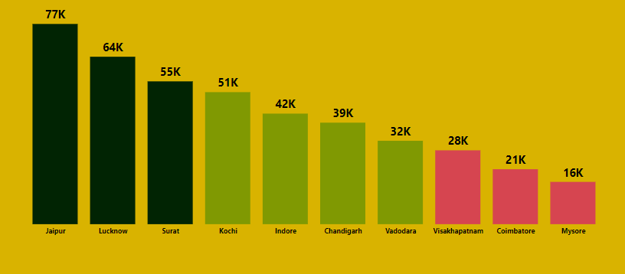
TOP AND BOTTOM PERFORMING CITIES

Slide 16

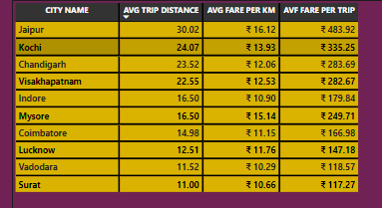
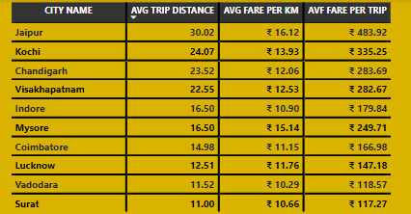
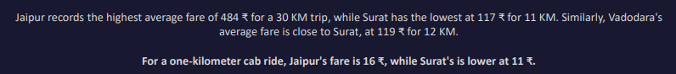

Slide 17
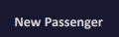
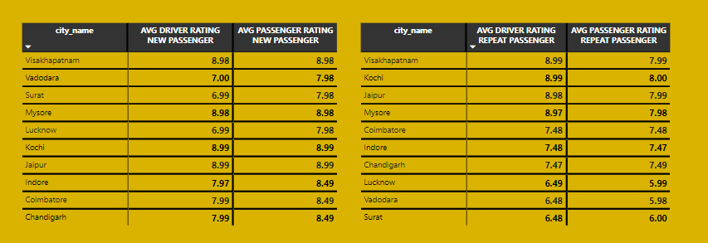

Slide 18
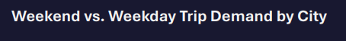
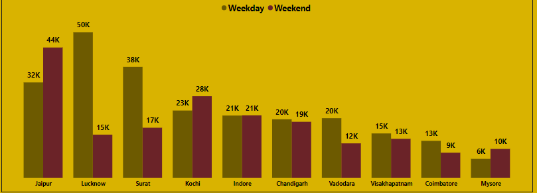
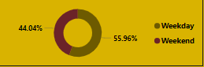
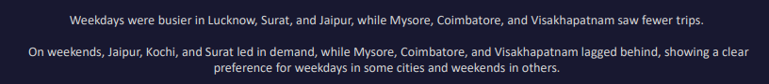

Slide 19
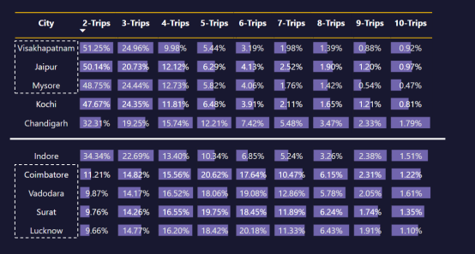
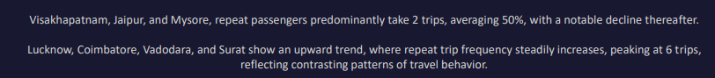

Slide 20
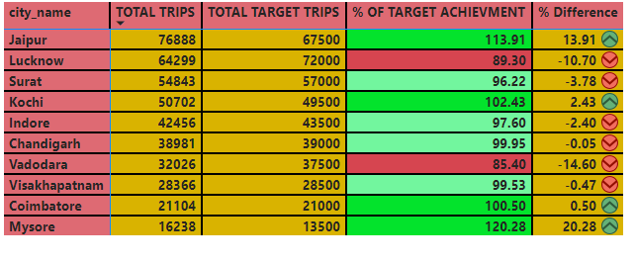
TARGET ACHIEVMENT ANALYSIS
KEY INSIGHTS:
JAIPUR,KOCHI,COIMBATORE,MYSORE ARE OVERACHIEVERS(ACHIEVED 100%+)
SURAT,INDORE,CHANDIGARHAND VIZAG ARE IMPROVING
LUCKNOW AND VADODARA ARE UNDERPERFORMED .

Slide 21
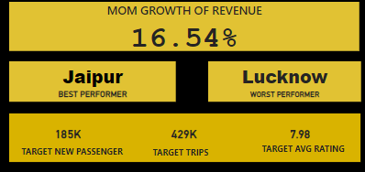
KPI’S

Slide 22
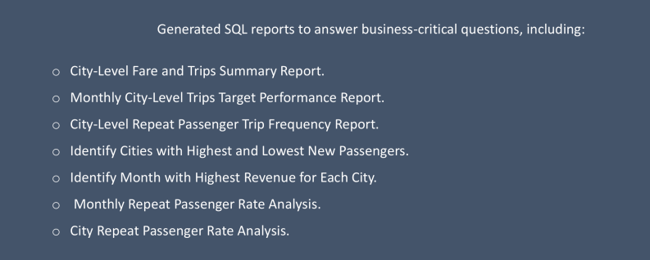
AD-HOC REQUESTS

Slide 23
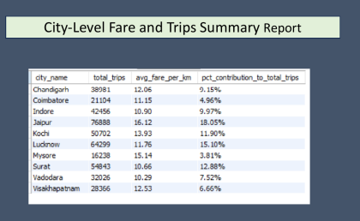
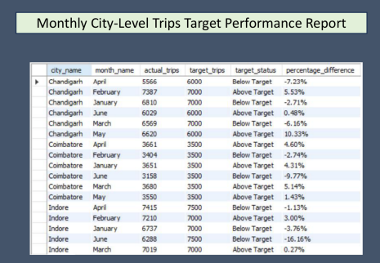

Slide 24
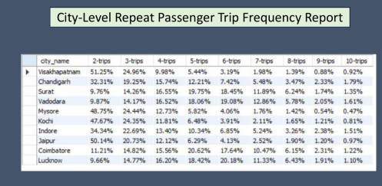
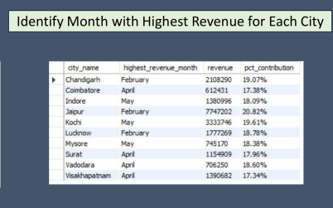
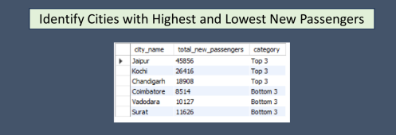

Slide 25
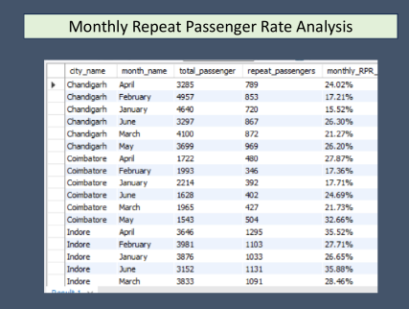
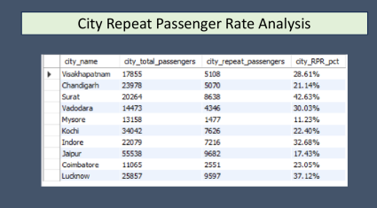

Slide 26

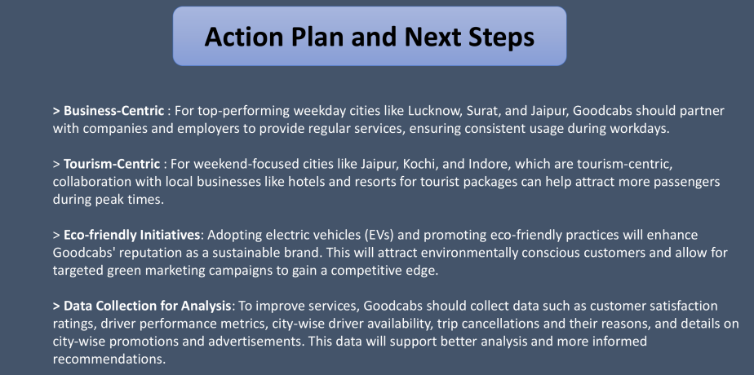

Slide 27
THANK
YOU

